Slide 1

Efficient Searchable Encryption Through Compression
Ioannis Demertzis
Rajdeep Talapatra
Charalampos Papamanthou
University of Maryland
University of Maryland
University of Maryland
yannis@umd.edu
rajdeep@umd.edu
cpap@umd.edu

Slide 2

Cloud Computing
Pros:
  Near infinite scalability for big data analytics
  Easy and ubiquitous access on solid data
  Cost reduction with the use of shared infrastructure
  + Affordable for small and medium businesses
Cons:
- Serious security and privacy concerns regarding
outsourcing and querying on private company or personal data
2

Slide 3
Ready or NoT, GDPR is Here!!!
GDPR is more flexible when data are encrypted
  e.g. all data breaches must be reported to the Data Protection Commission (DPC) within 72 hours unless the data are encrypted

Slide 5
Network Traffic Encryption
Device Encryption
File Share Encryption
Database Encryption
Folder Encryption
Full Disk Encryption
EMAIL Encryption

Slide 6
ENCRYPTION IS EVERYWHERE!!!
e.g. Full Disk Encryption
Usability?
Efficiency?
Functionality?

Slide 7



Solution for Encrypted Search
Secure & Efficient
Boolean Queries
[CJJ+13] in CRYPTO
[KM17] in EUROCRYPT
High
…
CryptDB
MONOMI
OPE
DET
Google BigQuery
SE
CipherBase
Graph Queries
[CK10] in ASIACRYPT
Microsoft SQL 2016
Always Encrypted
Efficiency
Efficient
Oblivious RAM
-> OSE
Range/Aggregate Queries
[FJK+15] in ESORICS
[DPP+16] in SIGMOD
[DPP+18] in TODS
FHE
Wildcard/Phrase/Substring
[FJK+15] in ESORICS
[LL17] in ePrint
Secure
Low
High
Security
Select-Project-Cross Product Queries
[KM18] ASIACRYPT
Naveed Muhammad et al. "Inference attacks on
property preserving encrypted databases." CCS 2015
4

Slide 8





What is Searchable Encryption (SE)?
Leakage is the amount of information that the untrusted cloud learns
Untrusted
Cloud
Client
?
search query:
keyword
5

Slide 9



Searchable Encryption (SE) schemes
Untrusted
Cloud
Client
k1
F1
F4
F2
k2
F3
F6
F4
F2
k3
F5
F1
F1
F2
F3
F4
F5
F6
6

Slide 10
Searchable Encryption (SE) schemes
Untrusted
Cloud
Client
k1
F1
F4
F2
k2
F3
F6
F4
F2
k3
F5
F1
F1
F2
F3
F4
F5
F6
6

Slide 11
Searchable Encryption (SE) schemes
Untrusted
Cloud
Client
Setup leakage: total leakage prior to query execution
e.g. size of each encrypted file, size of encrypted index
k1
F1
F4
F2
k2
F3
F6
F4
F2
k3
F5
F1
F1
F2
F3
F4
F5
F6
6

Slide 12
Searchable Encryption (SE) schemes
Untrusted
Cloud
  Search pattern: whether a search query is repeated
Query leakage: leakage during the query execution
Client
token
PRF()
PRF()
PRF()
k1
k1
F1
F4
F2
k2
F3
F6
F4
F2
k3
F5
F1
F1
F2
F3
F4
F5
F6
  Access pattern: encrypted document ids and files that satisfy the search query
6

Slide 13

Searchable Encryption (SE) schemes
Untrusted
Cloud
  Search pattern: whether a search query is repeated
Query leakage: leakage during the query execution
Client
token
PRF()
PRF()
PRF()
k1
k1
F1
F4
F2
k2
F3
F6
F4
F2
k3
F5
F1
T1
John | Smith | CMU | 27 | $3,000
  Result size
T2
Alice | Lu | UCLA | 28 | $4,000
TN
Bruce | William | UMD | 30 | $2,000
6

Slide 14
Keyword vs Database Search Problem
T1
John | Smith | CMU | 27 | $3,000
F1
F2
F3
F4
F5
F6
T2
Alice | Lu | UCLA | 28 | $4,000
…
TN
Bruce | William | UMD | 30 | $2,000
k1
F1
F4
F2
27
T1
T4
T20
k2
F3
F6
F4
F2
28
T2
T6
T12
T50
…
…
k3
F5
F1
30
T13
TN
Setup Leakage: N,m
Setup Leakage: N
SE-> leakage: Access + Search patterns
SE->leakage: Result size + search pattern

Slide 15


Oblivious Searchable Encryption (OSE) with ORAMs
?
Retrieve the i-th tuple without revealing value i to the server
Untrusted
Cloud
Client
  Solution 1: Download the entire database
T1
John | Smith | CMU | 27 | $3,000
T2
Alice | Lu | UCLA | 28 | $4,000
...
Ti
Mike | Jones | MIT | 24 | $6,000
...
TN
Bruce | William | UMD | 30 | $2,000

Slide 16
Oblivious Searchable Encryption (OSE) with ORAMs
?
Retrieve the i-th tuple without revealing the value i to the server
Untrusted
Cloud
Client
  Solution 2: Use ORAMs
  Intuition:
  For every single tuple access, access many tuples
  Move tuples around
T1
John | Smith | CMU | 27 | $3,000
T2
Alice | Lu | UCLA | 28 | $4,000
...
Ti
Mike | Jones | MIT | 24 | $6,000
  e.g. PathORAM: For every single tuple access
  reads O(log³N) additional tuples and shuffles them
  It also requires maintaining a local private memory (stash)
  of size ~O(log²N) tuples
...
TN
Bruce | William | UMD | 30 | $2,000

Slide 17
Oblivious Searchable Encryption (SE) schemes
Untrusted
Cloud
Client
Query leakage: leakage during the query execution
token
PRF()
PRF()
PRF()
k1
k1
F1
F4
F2
k2
F3
F6
F4
F2
k3
F5
F1
F1
F2
F3
F4
F5
F6
  Result size
7

Slide 18
Oblivious Searchable Encryption (SE) schemes
Untrusted
Cloud
Client
Query leakage: leakage during the query execution
token
PRF()
PRF()
PRF()
k1
k1
F1
F4
F2
k2
F3
F6
F4
F2
k3
F5
F1
T1
John | Smith | CMU | 27 | $3,000
  Result size
T2
Alice | Lu | UCLA | 28 | $4,000
TN
Bruce | William | UMD | 30 | $2,000
7

Slide 19
Keyword vs Database Search Problem
T1
John | Smith | CMU | 27 | $3,000
F1
F2
F3
F4
F5
F6
T2
Alice | Lu | UCLA | 28 | $4,000
…
TN
Bruce | William | UMD | 30 | $2,000
k1
F1
F4
F2
27
T1
T4
T20
k2
F3
F6
F4
F2
28
T2
T6
T12
T50
…
…
k3
F5
F1
30
T13
TN
Setup Leakage: N,m
Setup Leakage: N
SE-> leakage: Access + Search patterns
SE->leakage: Result size + search pattern
OSE-> leakage: Result size
OSE->leakage: Result size

Slide 20



Security of SE: Simulation-based definition
Real
Ideal
L_{SETUP} (
)
Simulator
Enc (
) + Enc(
)
&^*@h@&*^H4&*24
L_{QUERY}( w1 )
w1
token1
Adversary
^&*daUY@#*
…
…
wN
L_{QUERY}(wN)
tokenN
&k*&()#&*@

Slide 21
SE - Efficiency Dimensions
Search Time
Index size
Parallelism
Searchable Encryption
#Interactions
I/O Efficiency
Communication
overhead
Update Time
#Crypto operations
[DP17] in SIGMOD provides various trade-offs considering the above efficiency dimensions
8

Slide 22

Our Approach: General Idea of microSE/microOSE
microSE/microOSE with leakage Λ’,
where Λ’<=Λ
T
Apply any set C of Compression
Algorithms
T ’
Black box
SE/OSE
with Leakage Λ
Build the Inverted Index
Encrypted
Index
I
9

Slide 23




Our Approach: Combining Compression with Encryption
Compress(Encrypt(x))
Encrypt (Compress(x))
e.g. Compress(E21B74E9E4AC)
e.g. Encrypt (Compress(aabbbbbb))
Compression does
not affect SE’s security
Compression does
not affect security
The input distribution
leaks information
Good compression ratio
Compression becomes useless
Very good compression ratio
Utilize only the leakage from SE/OSE, e.g. result size
10

Slide 24
Our Approach: Uniform random id reassignments
Prior SE schemes: Each tuple identifier is a random string of κ bits
Compression of a sequence of
random strings of κ bits is useless
Solution: Assign an id chosen
uniformly at random from
the range [0, N − 1] (N = #tuples)
Achieves good compression ratio
Compression does not affect SE’s security
11

Slide 25

Our Approach: Compression Algorithms
Problem: Compress r identifiers that are uniformly distributed in the range [0, N-1], where N is the total number tuples and r the result size of a particular value.
We selected 2 compression algorithms based on: “Jianguo Wang, Chunbin Lin, Yannis Papakonstantinou, and Steven Swanson. An Experimental Study of Bitmap Compression vs. Inverted List Compression. SIGMOD 2017 ”
  EWAH
  FastPfor
  EWAH
  FastPFor
High
#IDs
Low
Explanations of the compression algorithms are not covered in this talk. Feel free to ask me during the poster session!
12

Slide 26
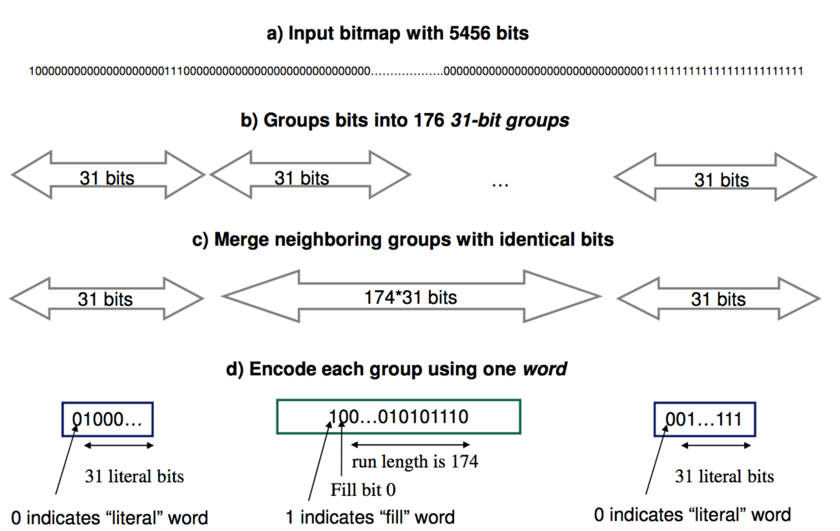
Word-Aligned Hybrid (WAH)

Slide 27
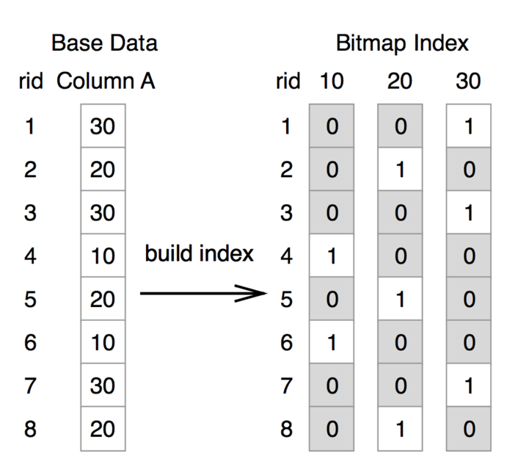
Enhanced Word-Aligned Hybrid (EWAH)
EWAH (Enhanced Word-Aligned Hybrid) is a bitmap index compression algorithm, which is an enhanced modification of WAH (Word-Aligned Hybrid)

Slide 28
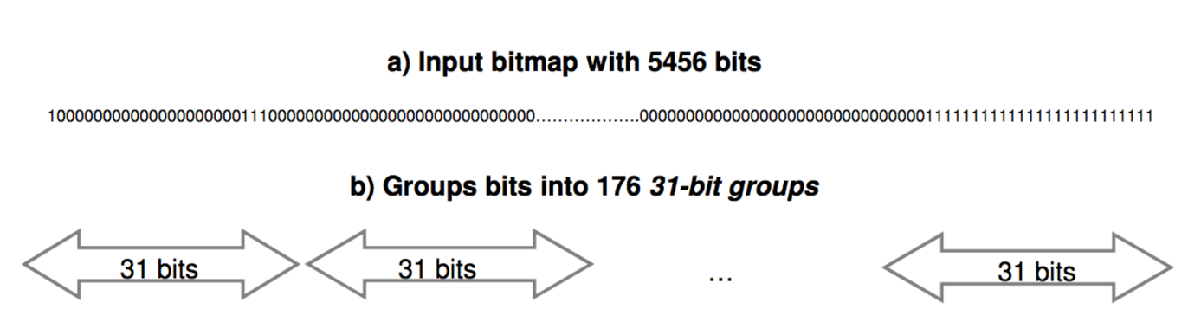
Enhanced Word-Aligned Hybrid (EWAH)
We modified EWAH to have groups of size O(λ) bits instead of
N bits
λ bits groups
λ bits
λ bits
λ bits
  EWAH
  FastPFor
High
#IDs
Low
O(N/λ)

Slide 29
FastPfor
FastPforDelta is a modification of PforDelta
Given a list of n integers, the algorithm begins by computing the deltas between two consecutive integers
  For example, let I = {2, 5, 10, 17}
  ➔ the computed deltas would be I’ = {2,3,5,7}
It proceeds with compressing the deltas.
  The deltas are then split into chunks of 128 deltas compressed separately.
  For each chunk, the scheme chooses the smallest b, such that a majority of elements (say 90%) can be encoded using b bits.
  The chunks are then stored using 128 b-bit locations, in addition to some extra storage for the values that could not be represented by the b bits (called exceptions).

Slide 30
Our Approach: Compress the index
r
C is a set of compression algorithms
T(28) =
28
T2
T6
T12
T50
…
T62
T69
T79
T96
Compress (C, T(28) )
Greedily choose the best compression algorithm
Y =
Pad T ’ to contain N entries
<= r * logN bits
Partition (Y)
T ’(28) =
28
0
1
λ bits
λ bits
I ← SE. Setup(k, T ’ ')
rank
rank
13

Slide 31
Our Approach: Compress the index
r
Without Compression
T(28) =
28
T2
T6
T12
T50
…
T62
T69
T79
T96
λ bits per id
r crypto ops
Compress (C, T(28) )
Y =
<= r * logN bits
Partition (Y)
With Compression
T ’(28) =
28
0
1
r’ crypto ops
λ bits
λ bits
r’<= r
r’
13

Slide 32
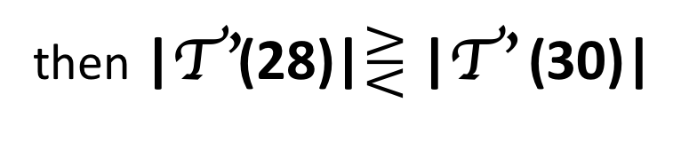
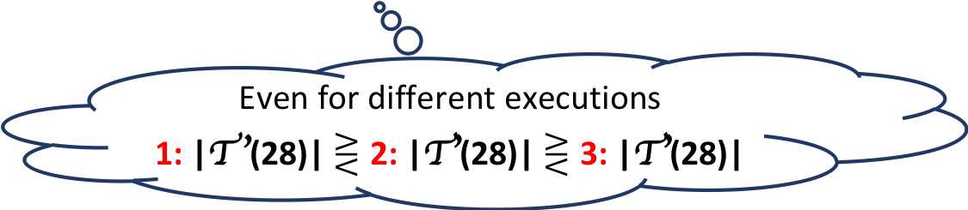
Our Approach: microSE/microOSE
?Security Issues?
then |T ’(28)|$⋛$ |T ’ (30)|
microSE: Assume that |T(28)| = |T(32)|
Even for different executions
1: |T ’(28)| $⋛$ 2: |T’(28)| $⋛$ 3: |T’(28)|
No security issues: (1) The distribution of the ids in all of these cases is the same (uniform)
(2) By leaking the search pattern the adversary knows that T ’(28) and T ’(30) are different queries
Solution 1:
Compress*(C, T(28) )
pads to the worst-case
microOSE: |T ’(28)|$\text{has} \text{to} \text{be} \text{equal} \text{to}$|T ’ (30)|
Solution 2:
since the search pattern is not leaked !!!
Store the overflowed
lists in a local stash
on the client side
14

Slide 33
Experiments - Setup
Used black-box SE scheme is PiBas (Cash et al. [CJS+14])
  → microSE(PiBas)
Used black-box ORAM scheme is PathORAM (Stefanov et al. [SDS+12])
  → microOSE(PathORAM) + Solution 2*
Java implementation using JavaX.crypto and Bouncy Castle libraries
64bit machine with Intel Xeon E5-2676v3 with 64GB RAM
*Local stash for solution 2 was always smaller than the stash of PathORAM
15

Slide 34
Experiments - Datasets
Database Search
Chicago crime incidents dataset
  6,123,276 records
  22 attributes with different distributions:
    ID, Case Number, Date, Block, ICR, Primary Type, Description,
    Location Description, Arrest, Domestic, Beat, District, Ward,
    Community Area, FBI Code, X Coordinate, Y Coordinate, Year,
    Updated On, Latitude, Longitude, Location.
Keyword Search
Enron email dataset
  30,109 emails of 150 employees of the Enron corporation sent between 2000-2002
16

Slide 35
Experiments – Setup Costs

Slide 36
Experiments – Keyword Search
  Enron Dataset
    76,577 distinct queries
    min query = 1 tuple
    max query = 24,642 tuples
    #emails = 30,109
~188x
  Both microSE(PiBas) and microOSE(PathORAM) are up to 188x more efficient than PiBas and PathORAM
17

Slide 37
Experiments – Database Search
20 minutes via 21 hours
  Crime Dataset
    location description attribute
    173 distinct queries
    min query = 1 tuple
    max query = 1,631,721 tuples
~62x
~21x
  microSE(PiBas) is up to 62x more efficient than PiBas
  microOSE(PathORAM) accesses 1,5M tuples in 20 minutes vs 21 hours of PathORAM
18

Slide 38
Experiments – Database Search

Slide 39
Experiments – Database Search
Binary Attributes
Unique attributes
Location description
attribute
#Unique Values ~= N
19

Slide 40

Conclusion
  New efficiency dimension for SE: #cryptographic operations to retrieve query results
  Use any set of lossless compression algorithms and any SE/OSE schemes as black-boxes to improve their search efficiency without affecting their security
  Keyword search time savings: up to 188x (Enron dataset)
  Database search: up to 62x (location description attribute),
  170-203x (binary attributes).
  Our OSE approach reduces the index search time to access 1,5M tuples from 21 hours to 20 minutes
Build the Inverted Index
T
Apply any set C of Compression
Algorithms
T ’
Black box
SE/OSE
with Leakage Λ
Encrypted
Index
I
20

Slide 41

Thank You! Questions?
  New efficiency dimension for SE: #cryptographic operations to retrieve query results
  Use any set of lossless compression algorithms and any SE/OSE schemes as black-boxes to improve their search efficiency without affecting their security
  Keyword search time savings: up to 188x (Enron dataset)
  Database search: up to 62x (location description attribute),
  170-203x (binary attributes).
  Our OSE approach reduces the index search time to access 1,5M tuples from 21 hours to 20 minutes
Build the Inverted Index
T
Apply any set C of Compression
Algorithms
T ’
Black box
SE/OSE
with Leakage Λ
Encrypted
Index
I
21

